Slide 1

Task 2: Predicting customer buying behavior.

Slide 2
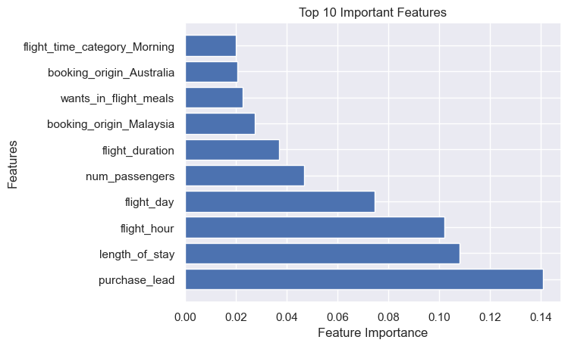
factors that influence buying behavior the most are:
1- purchase_lead 2- length_of_stay
3- flight_hour 4- flight_day
5- num_passengers 6- flight_duration
7- booking_origin_Malaysia
8- wants_in_flight_meals
9- booking_origin_Australia
10- flight_time_category_Morning
Predictive Model: Random Forest Classifier
Mean Accuracy: 0.850125
confusion_matrix:
[[8324 162]
[1330 184]]

